Slide 1
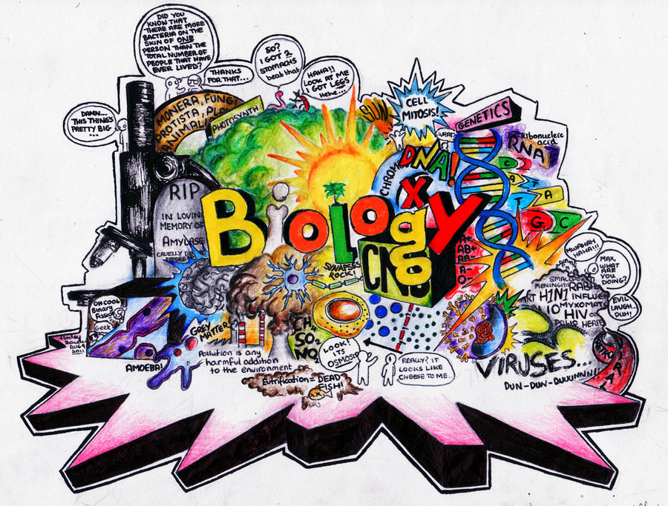

Slide 2
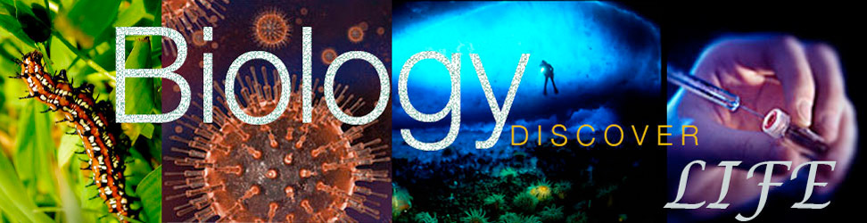
Review: The Brain
The brain controls and regulates body functions. Without it you cannot survive.
MRI (magnetic resonance imaging), uses strong magnetic fields to distinguish different types of body tissue.

Slide 3
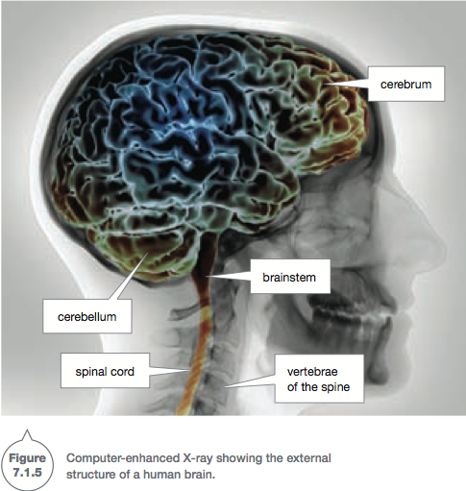
This is useful in diagnosing brain tumors and finding areas of brain injury.
Damage to the brain is repaired slowly.

Slide 4
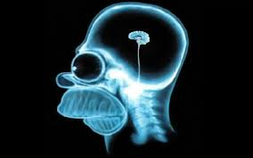
Parts of the Brain

Slide 5
Cerebrum
Occupies more than 80% of the brain and contains over 10 billion neurons (nerve cells).
Its many folds increase its surface area by three times.
It is here that the higher intellectual functions of humans take place.
The cerebrum controls your conscious thoughts and the intentional (voluntary) movement of every body part.
It also receives sensory messages from all body parts.

Slide 6
Cerebellum
At the base of the cerebrum, where you can feel your skull curve inwards, is the cerebellum.
The cerebellum is responsible for coordination and balance.
Without it, walking would be impossible.

Slide 7
Medulla/ Brain stem
The lower part of the brain stem or medulla can be seen where the spinal cord widens just after it passes into
the skull.
It controls the body’s vital functions, such as breathing, blood pressure and heart rate.
Damage to this area can be fatal.

Slide 8

Pituitary Gland
A tiny gland that is responsible for many processes such as growth, reproduction, stress, metabolism and many more.
It releases hormones to regulate other glands in the body.
It is regulated by the hypothalamus.

Slide 9
Hypothalamus
The hypothalamus has many jobs, but the most important is to link the nervous system to the endocrine system (glands and hormones).
It links the two by regulating the pituitary gland.
The hypothalamus and the pituitary gland are joined.

Slide 10
Corpus Callosem
A “helmet like” structure, which acts as a bridge between the left and right hemispheres of the cerebrum.
Impulses travel across the corpus callosem from one hemisphere to another.

Slide 11
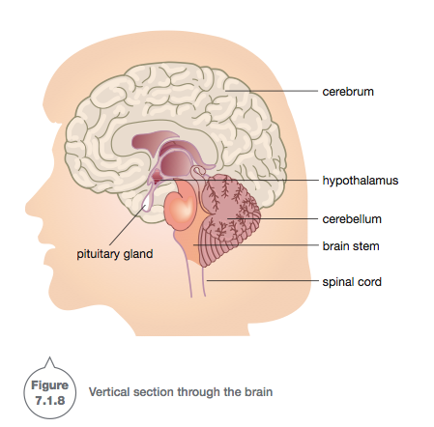

Slide 12
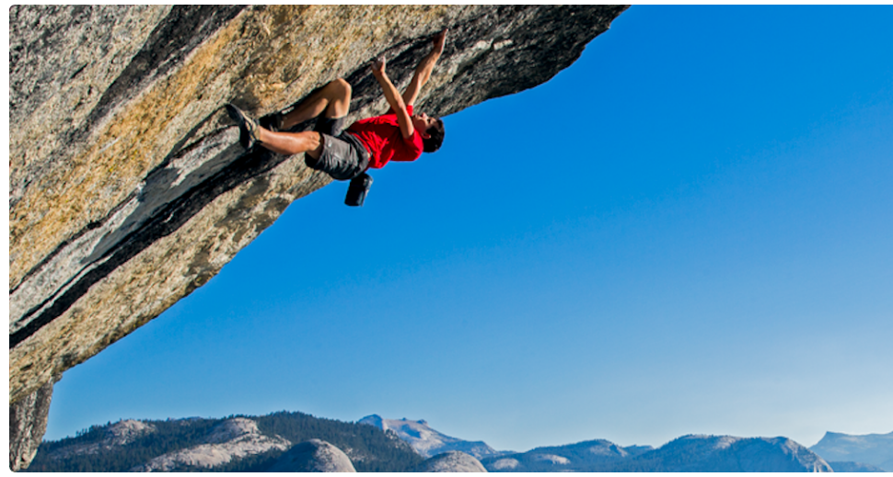
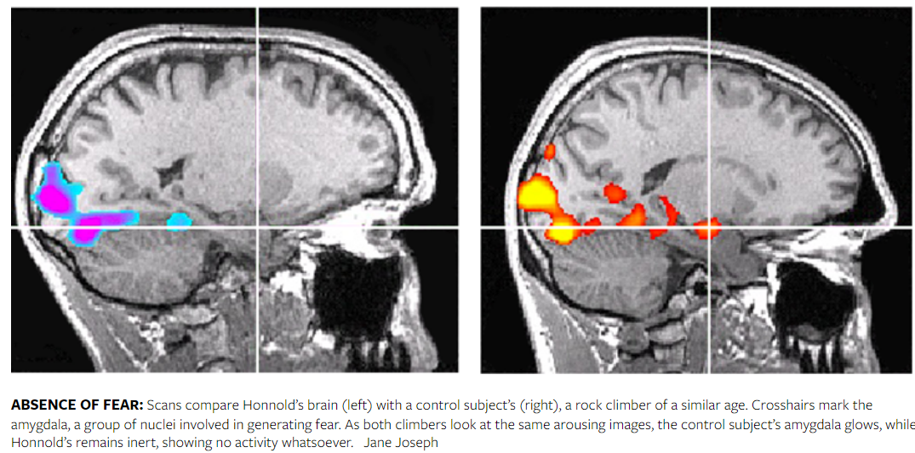
Alex Honnold

Slide 13
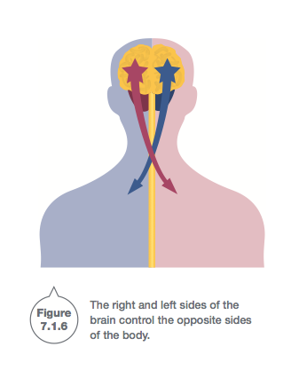
The cerebrum is made up of two parts, called the right and left cerebral hemispheres.
When it comes to intended actions such as walking or hitting a ball, the right hemisphere controls the left side of your body and the left hemisphere controls the right side of your body.

Slide 14
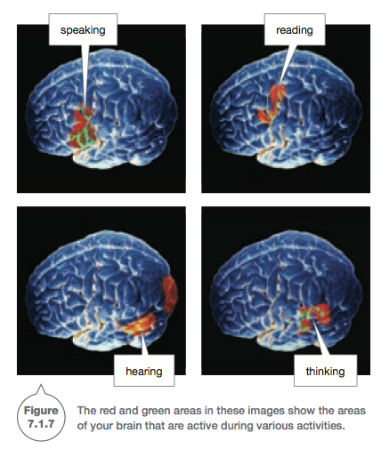

Slide 15
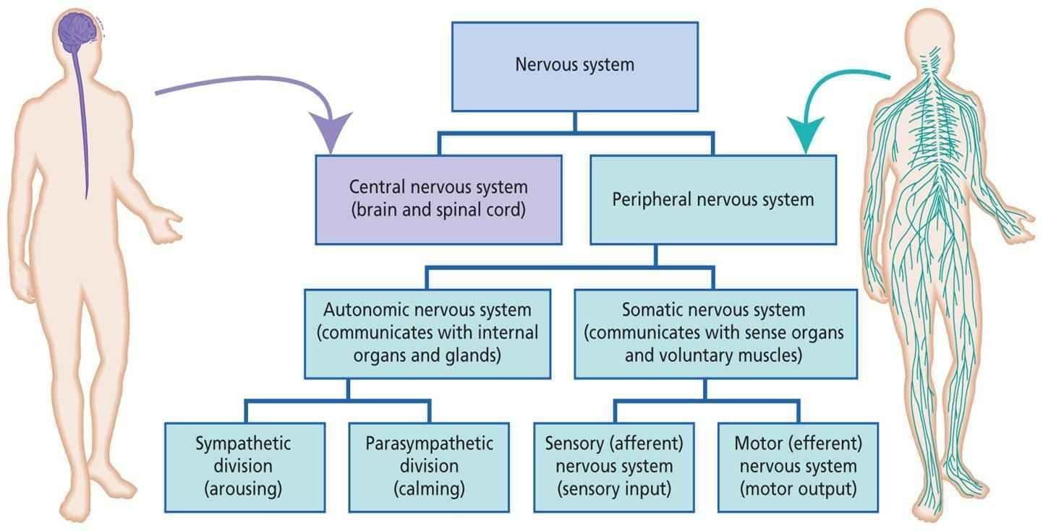
Anatomizing the nervous system
The nervous system is composed of: CNS and PNS.
PNS can further be broken down into Autonomic (involuntary) and Somatic (voluntary)

Slide 16
1: The somatic nervous system (which controls information through the sense organs).
2: The autonomic nervous system.

Slide 17
Some of the activities of your body happen without you realising it. The beating of your heart, the movement of food in your intestines, sweating and pupil size are controlled by the autonomic nervous system.
Two parts of the autonomic nervous system are the sympathetic nervous system and the parasympathetic nervous system.

Slide 18

The sympathetic nervous system speeds up the functions of the body and makes it work more efficiently.
It is the system that prepares your body for emergencies by making you more alert and preparing your body to act.

Slide 19
The Parasympathetic nervous system slows everything down. It is the system in control when you are resting.

